Slide 1
Notes:
START
Play the rhythm of the first two measures of the song on the hand drum. Repeat until all students are seated. Encourage students to move, clap or pat along with the drum. SAY The sound of the drum really makes you want to dance, doesn’t it?

Slide 2
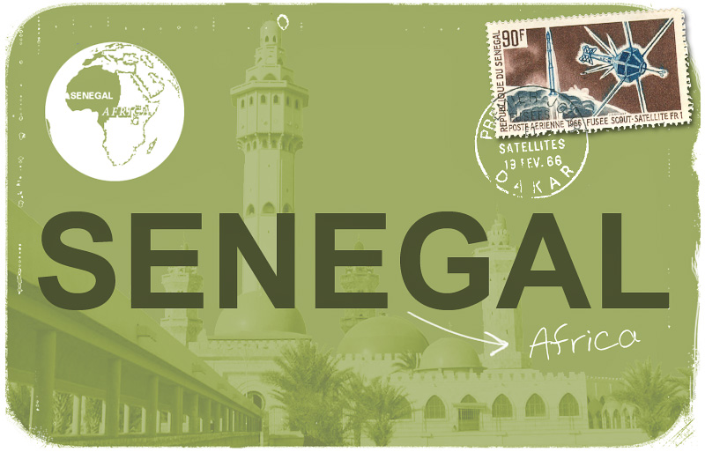
Notes:
Today we will
Learn about the geography, music and culture of Senegal
Sing a traditional Senagalese folk song
Today we are going to learn about a country that is famous for its wonderful drumming. We are going to the continent of Africa to the country called Senegal, our next stop on this Musical Planet.

Slide 3
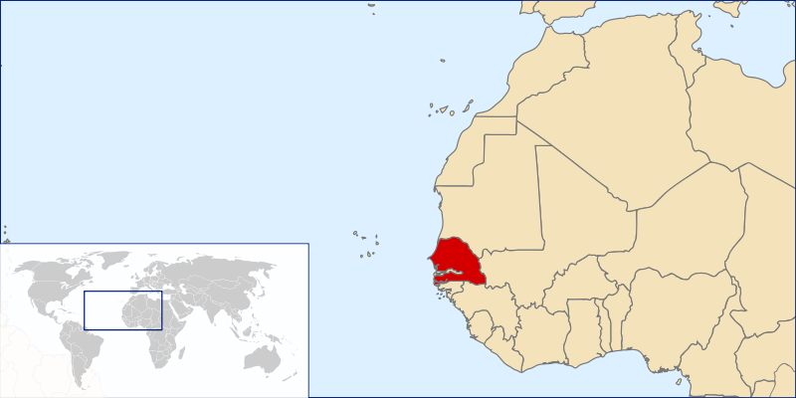
Senegal
Notes:
Senegal is a small country in West Africa (slightly smaller than South Dakota), with a population of almost 13 million. Its capital, Dakar is the westernmost point on the African continent. Senegal surrounds Gambia on three sides and is bordered on the north by Mauritania, on the east by Mali, and on the south by Guinea and Guinea-Bissau. It has a short coastline on the Atlantic Ocean. A low-lying country, Senegal has a semi-desert area in the north and northeast and forests in the southwest.
The Senegalese landscape consists mainly of the rolling sandy plains of the western Sahel which rise to foothills in the southeast. The local climate is tropical with well-defined dry and humid seasons that result from northeast winter winds and southwest summer winds. The dry season (December to April) is dominated by hot, dry, harmattan wind.

Slide 4
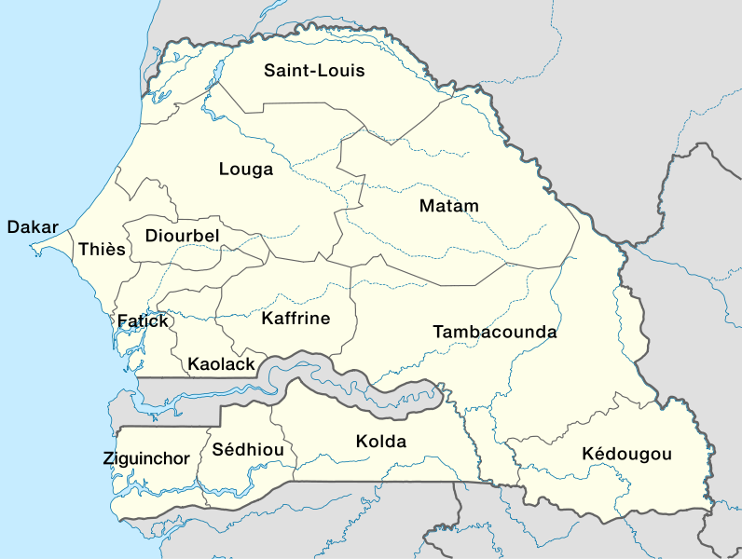
Notes:
Senegal is subdivided into 14 regions,^{[23]} each administered by a Conseil Régional (Regional Council) elected by population weight at the Arrondissement level. The country is further subdivided by 45 Départements, 103 Arrondissements (neither of which have administrative function) and by Collectivités Locales, which elect administrative officers.^{[24]}
Regional capitals have the same name as their respective regions:
Dakar
Diourbel
Fatick
Kaffrine
Kaolack
Kédougou
Kolda
Louga
Matam
Saint-Louis
Sédhiou
Tambacounda
Thiès
Ziguinchor

Slide 5
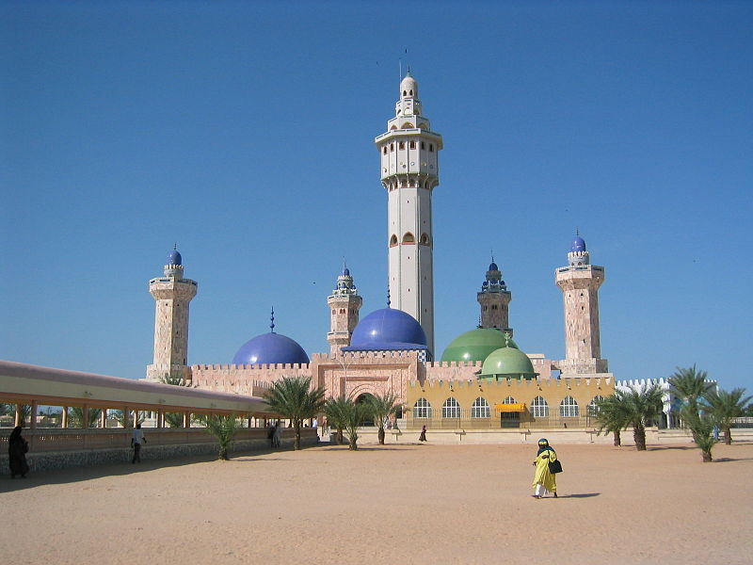
Notes:
During the colonial era, Senegal was colonized by France, and the people grew to adopt a French identity.
Senegal has a wide variety of ethnic groups and, as in most West African countries, several languages are widely spoken. The Wolof are the largest single ethnic group in Senegal at 43 percent; The vast majority of the Wolof people are Sufi Muslims. French is the official language, used regularly by a minority of Senegalese educated in a system styled upon the colonial-era schools of French origin. Islam is the predominant religion in the country. Islam is practiced by approximately 94 percent of the country's population; the Christian community, at 5 percent of the population. A mosque is a place of worship for followers of Islam.

Slide 6
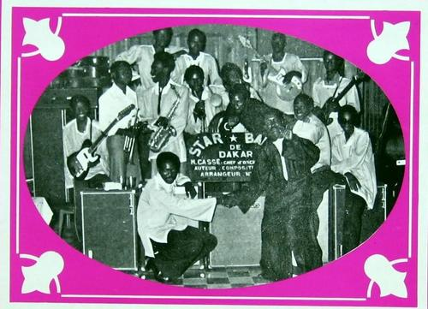
Notes:
Senegal's musical heritage is better known than that of most African countries, due to the popularity of mbalax, which is a form of Serer percussive music; it has been popularized by Youssou N'Dour. Sabar drumming is especially popular. Senegalese popular music can be traced back to the 1960s, when nightclubs hosted dance bands (orchestres) that played Western music. Ibra Kasse's Star Band was the most famous orchestre.

Slide 7
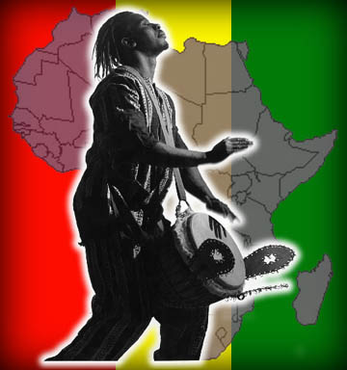
Notes:
Senegal is famous among African cultures for its music due to the popularity of mbalax, which is a form of percussive music; it is also the name of the national popular dance of Senegal. All forms of drumming are also especially popular. Senegalese folk music is very uptempo and lively, and there are many dances which are named after the type of drum used to accompany them.
Now, let’s learn some more about this West African nation as we travel to Senegal with John Jacobson.
http://www.youtube.com/watch?v=6rulqn3zjb8&list=PLC76F47C132AF79E4&index=7

Slide 8
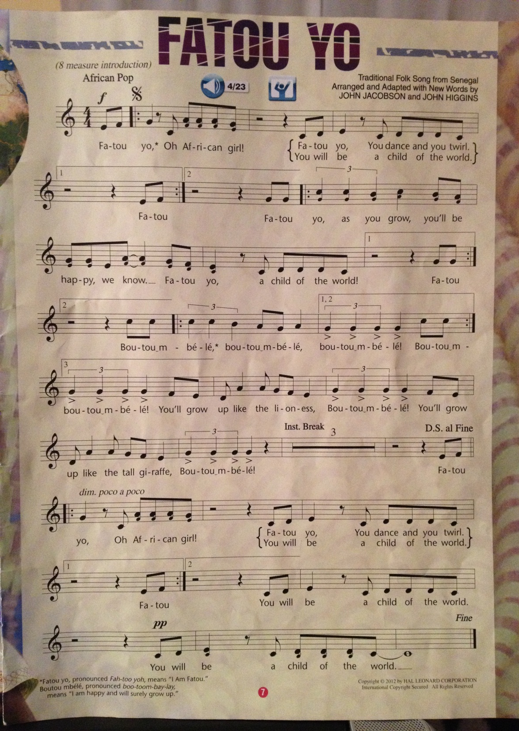
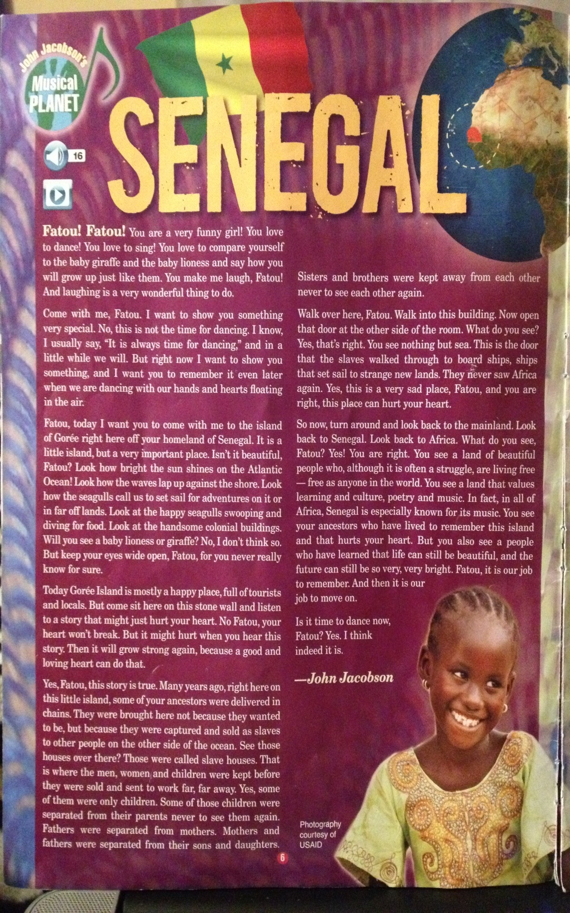

Slide 9
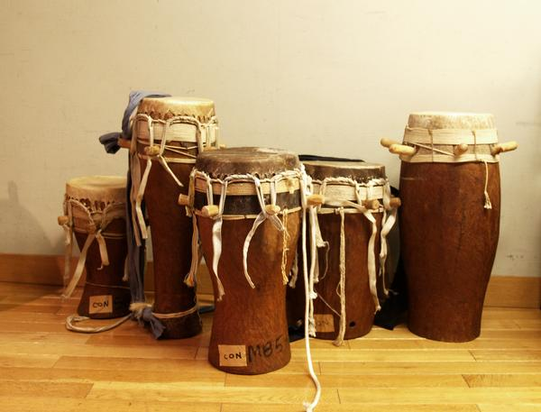
Sabar
Notes:
African Drums – Sabar (most common instrument in Senegal),
https://www.youtube.com/watch?v=CSsQVWvggtI

Slide 10
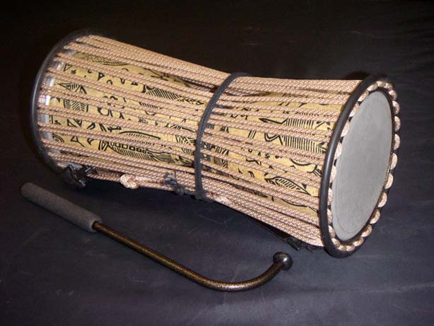
Tama
Notes:
Tama (talking drum) The talking drum is an hourglass-shaped drum from West Africa, whose pitch can be regulated to mimic the tone and prosody of human speech. Its body is covered by two skins which are connected by leather strings, which allow the player to tweak its pitch by pressing the drum between his arm and body. A skilled player is able to play whole melodies and phrases. Other speech-mimicking drums of conical or tubular construction exist around Africa, but they are generally known by their particular names instead of the term "talking drum". Examples include the Akan Fontomfrom and the Bantu Ngoma.
https://www.youtube.com/watch?v=nnNvZWmsnTg

Slide 11
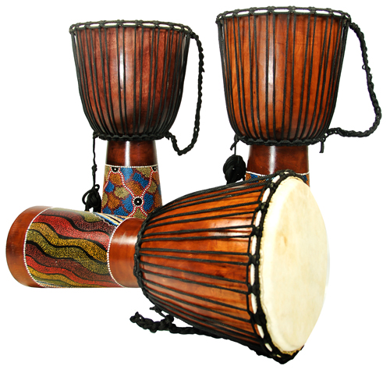
Djembe
Notes:
Djembe (large goblet shaped drum)
Djembe orchestra
https://www.youtube.com/watch?v=WbVcLZRbGfA
How they make djembe’s VERY COOL
https://www.youtube.com/watch?v=aLeede5z1vQ

Slide 12
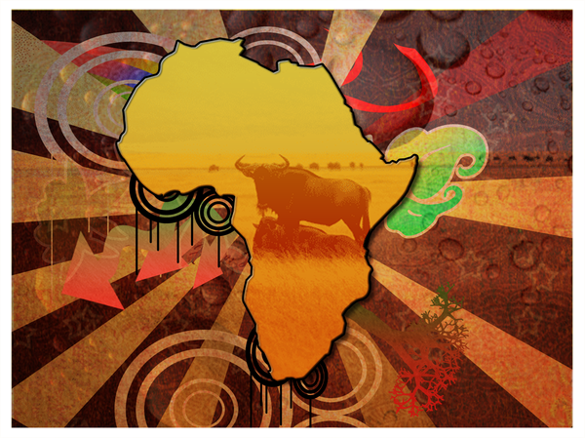
Notes:
doudou n'diaye rose – rose rhythm
https://www.youtube.com/watch?v=TlG3xLIPX7c

Slide 13
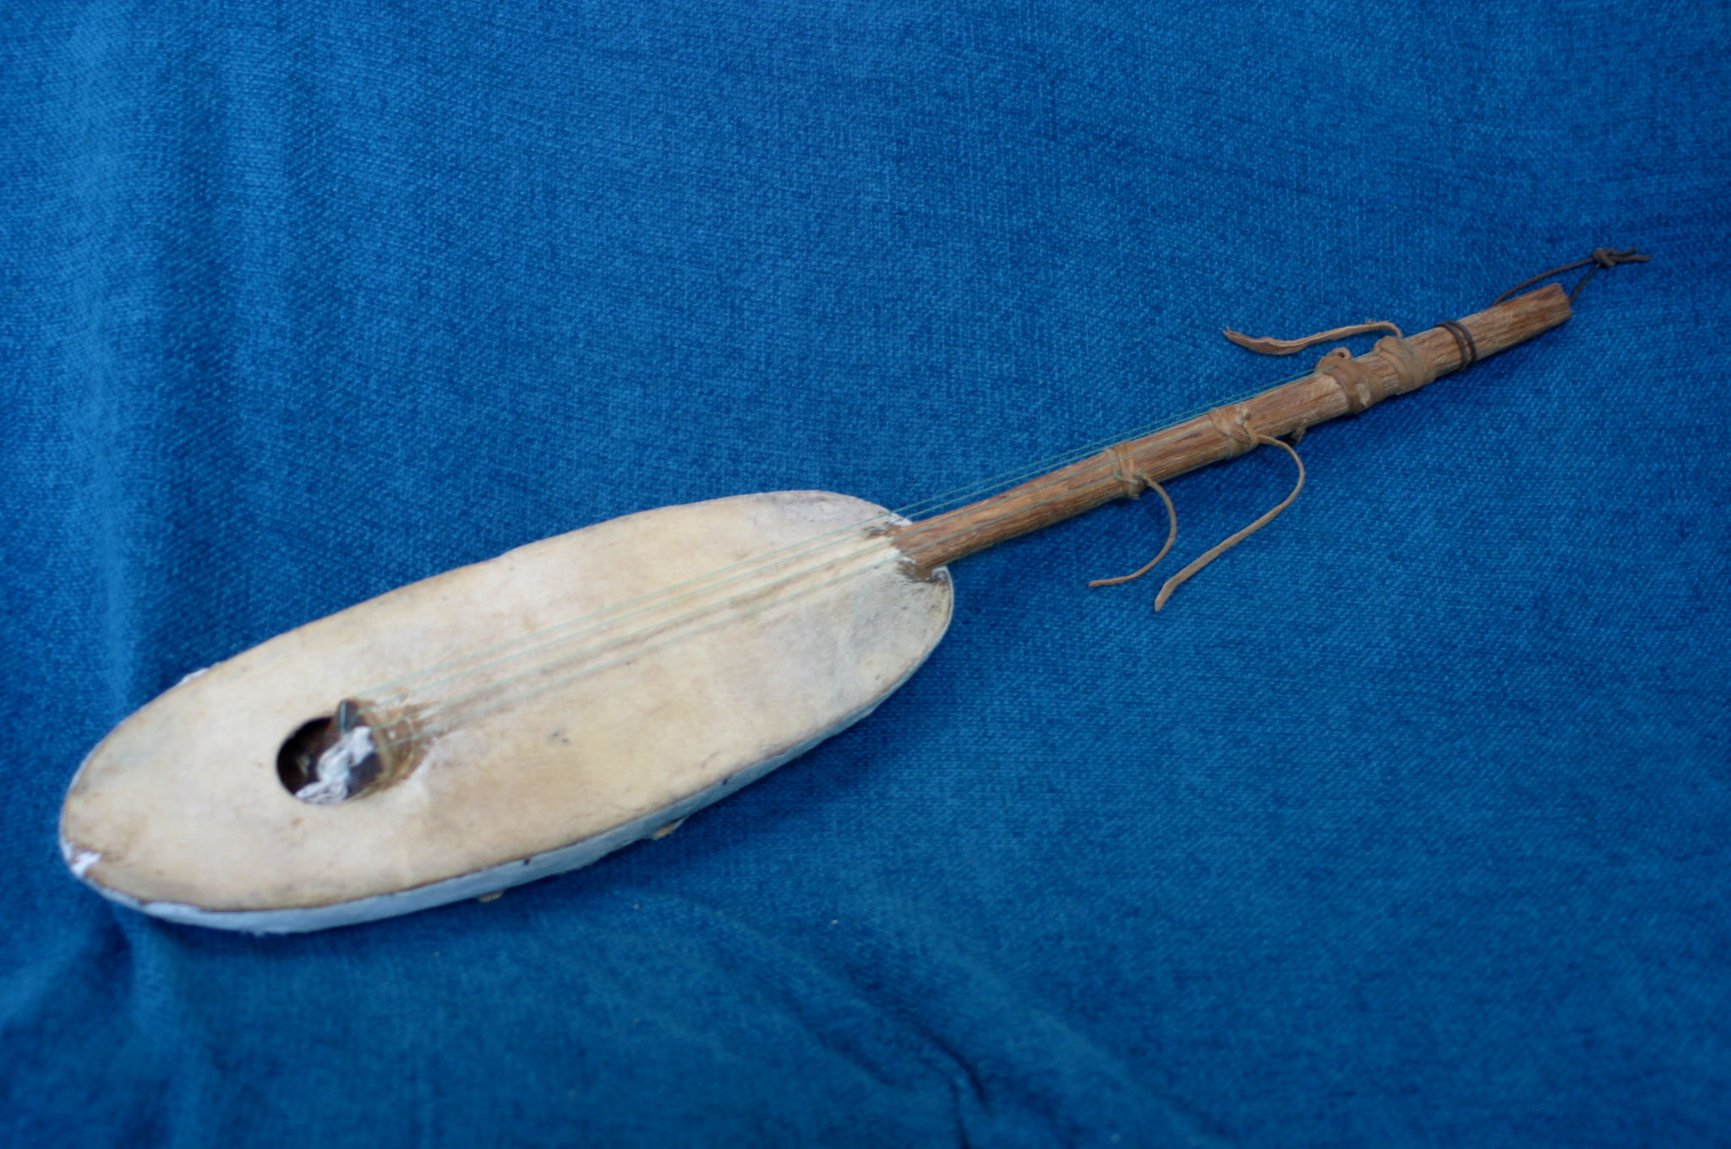
Xalam
Notes:
African Stringed Instruments –
Xalam, also spelled khalam, is the Wolof name for a traditional stringed musical instrument from West Africa. The xalam is thought to have originated from modern-day Mali, but some^{[who?]} believe that, in antiquity, the instrument may have originated from Ancient Egypt. Many believe^{[who?]} that it is an ancestor to the American banjo.
Xalam (most common stringed instrument in Senegal)
https://www.youtube.com/watch?v=kOaLjU1CyTE

Slide 14
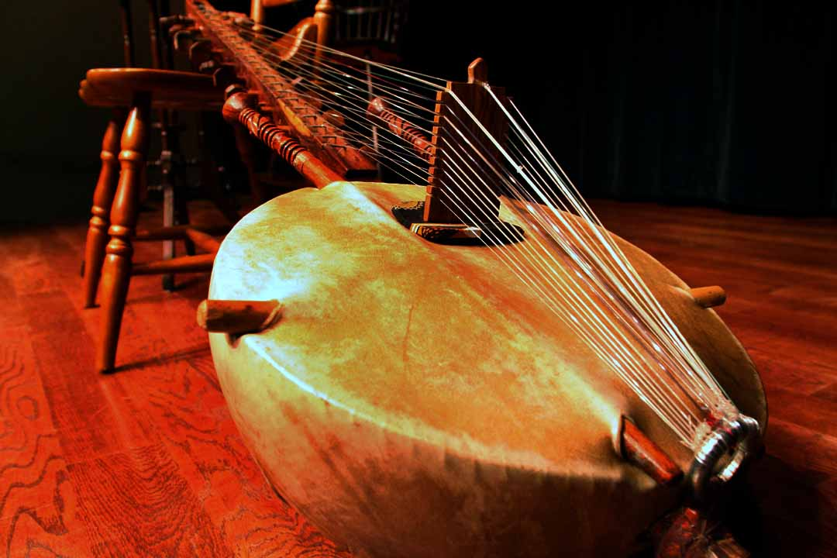
Kora
Notes:
Kora (21-stringed harp lute)
https://www.youtube.com/watch?v=wneaapj9as8

Slide 15
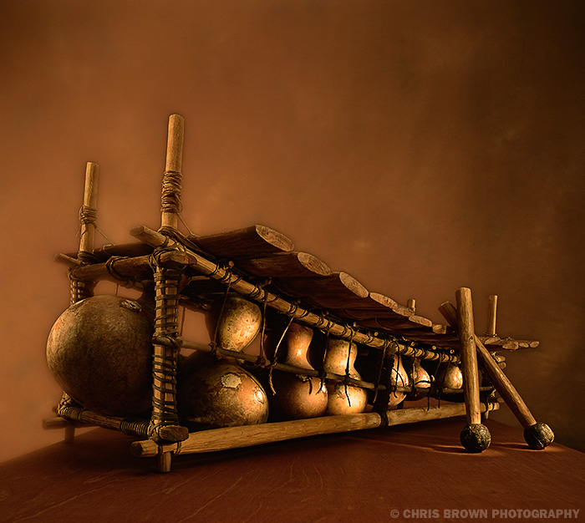
Balafon
Notes:
Balafon-both percussive and melodic, the balafon is made of 17-21 rectangular wooden slats laid on a frame amplified from below with gourds. Like a xylophone or marimba, it is struck with mallets.
https://www.youtube.com/watch?v=kXXhp_bZvck

Slide 16
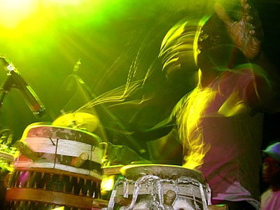
Mbalax
Notes:
Mbalax – the national popular dance music of Senegal

Slide 17
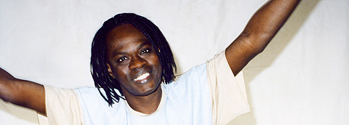
Notes:
Yela – a traditional rhythm from Senegal that mimics the sound of women pounding grain, with a weak sound (soft clap) on beat 1 and a stressed sound (calabash, or shaker gourd) on beat 3.
Baaba Maal – a popular musician from Senegal
Yela
https://www.youtube.com/watch?v=wxumKErHl50

Slide 18
