Slide 1
INTRO TO SENEGAL: People, Politics, and music

Slide 2
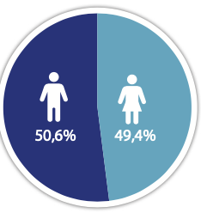
A fastly growing population
Population: 18 032 473 (2023)
Female/ Male : 49.4/50.6 (2023) against (50.2/49.2, in 2013)
Urban / rural: 45,94 / 54,04
Household size: 9 people (6 in Dakar)
Population average annual growth
1976 – 2013: 2.6%,
2013-2023: 2.9%
Rural: 1.7%
Urban: 3.5%
Fertility rate: 4.5 children per woman
Source: ANSD, RGPHAE, 2023

Slide 3
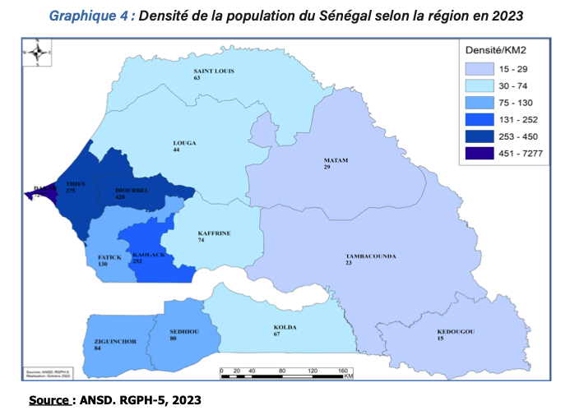
An unevenly distributed population
25% of the population live in 0.3% of the territory
The population is more concentrated in the Western part

Slide 4
A young and dependent population
Age Structure
Average age: 19
Median age: 19 (18 for men and 20 for women)
Over 60% are under 25
About 42% of the population is under 14
Less than 4% are 65 and above
Life expectancy: 68
Discussion: What are possible challenges and opportunities the demographic profile could create?

Slide 5
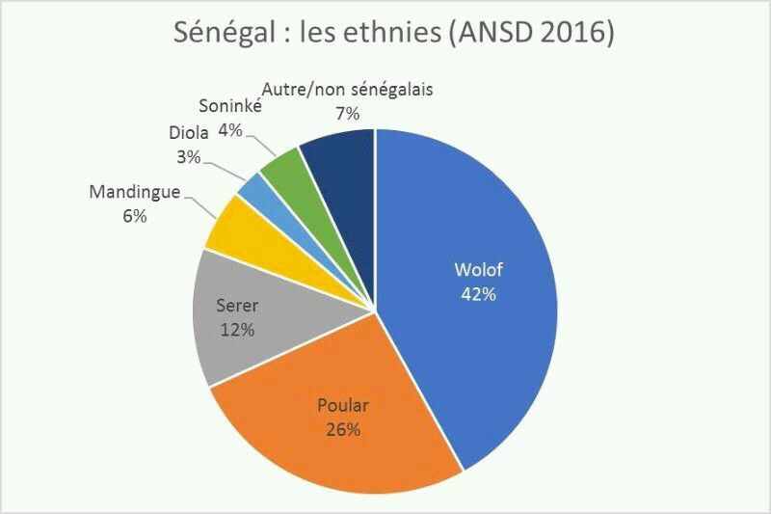
ethnic diversity in a cohesive environment
Ethnic groups
More than 20 ethnic groups
Islam promoted Wolof
Language survival strategies
Joking relationship
Between ethnic groups
Between family names
Between cousins
Between generation

Slide 6
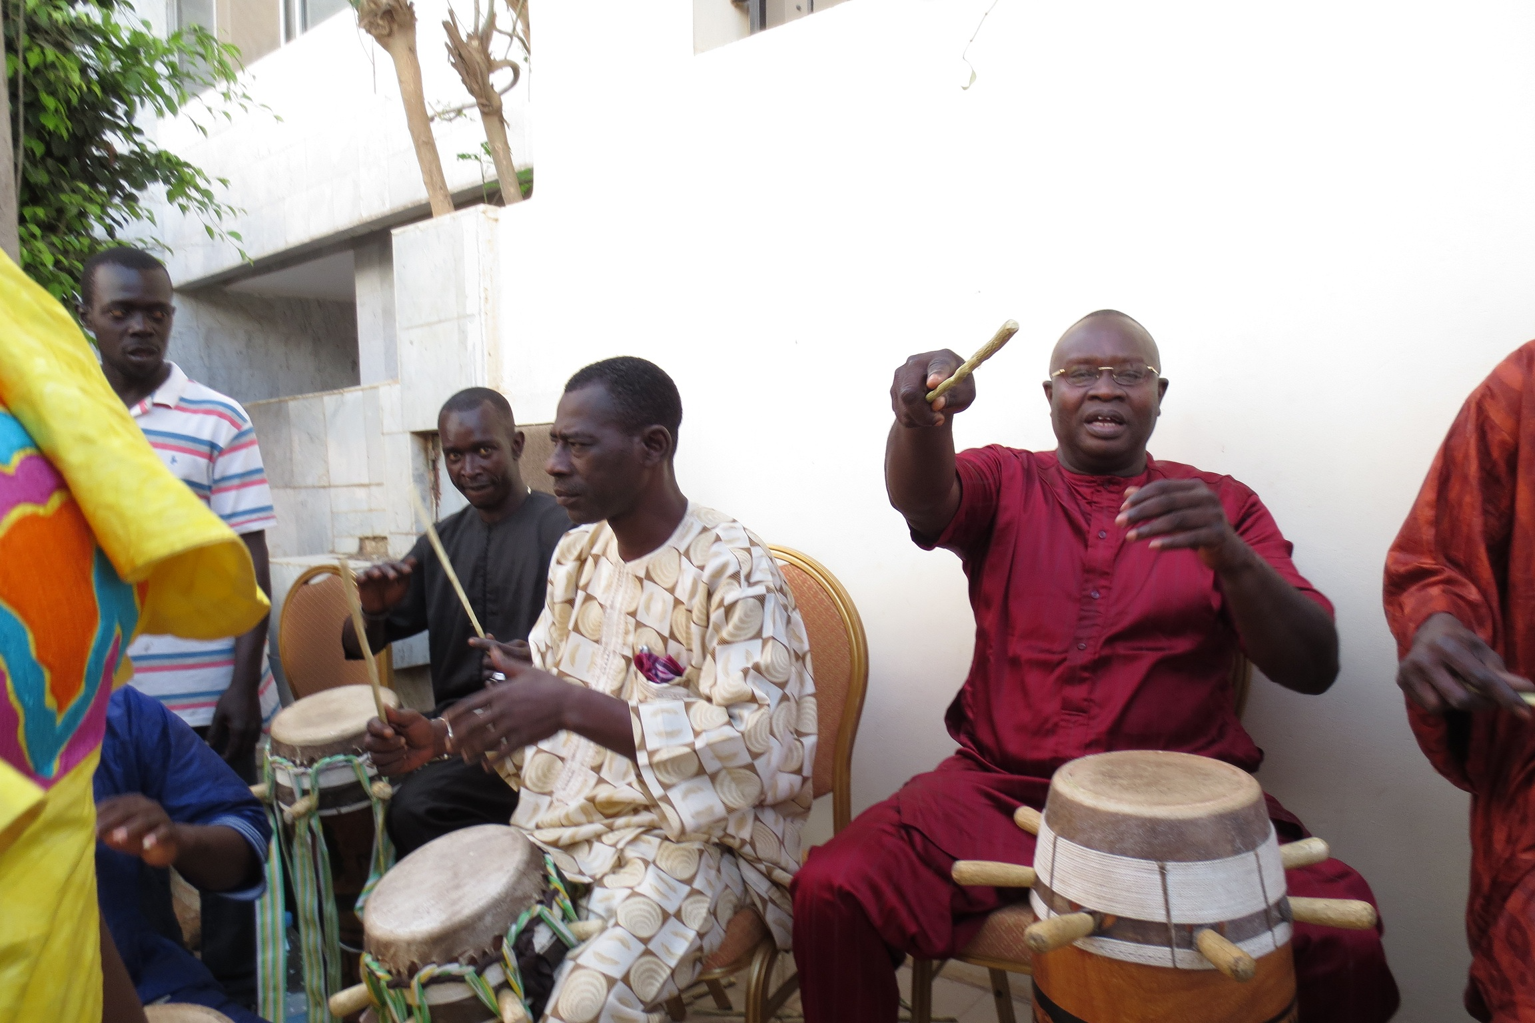
A CASTE SYSTEM transformed by urbanization and globalization
GEER (Noble)
Gewel (Griot)
Ñeño (Jëf lekk)
Tëgg (blacksmith and jeweller)
Laobe (woodworker)
Uude (leather worker)
Rabb (weaver)
Jaam (slave)

Slide 7
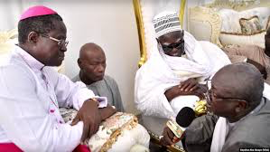
A long history of religious tolerance threatened
Predominantly Muslim (around 95%)
2 Locally founded brotherhoods (Murid and Layen)
2 imported brotherhoods (Qadr and Tijaan)
Reformist groups (Al Fala from Saudi Arabia and Jamatu Ibadurahman from Iran)
Christians 4% (dominantly catholic)
Tradition religions 1%
Religious syncretism and mysticism
Interfaith dialogue: The government promotes religious tolerance and dialogue between different faiths.

Slide 8
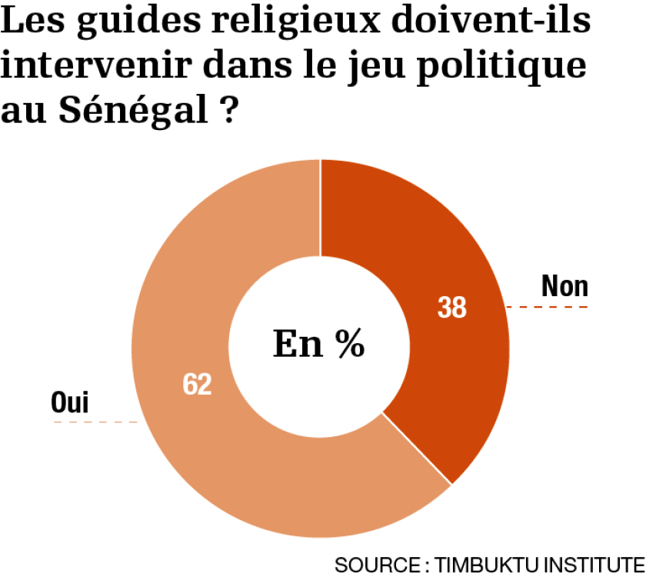
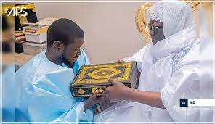
Politics and social diversity: no, that’s too sensitive
Avoidance as a strategy. « Don’t talk about it in public »
Ethnic group-based voting is a reality
Region-based voting is a common practice
Voting decisions based on brotherhood and caste system are fading out
Secular state: Senegal is officially a secular state, but religion plays a significant role in political life.
Political rhetoric: Politicians often use religious language and imagery in their campaigns.

Slide 9
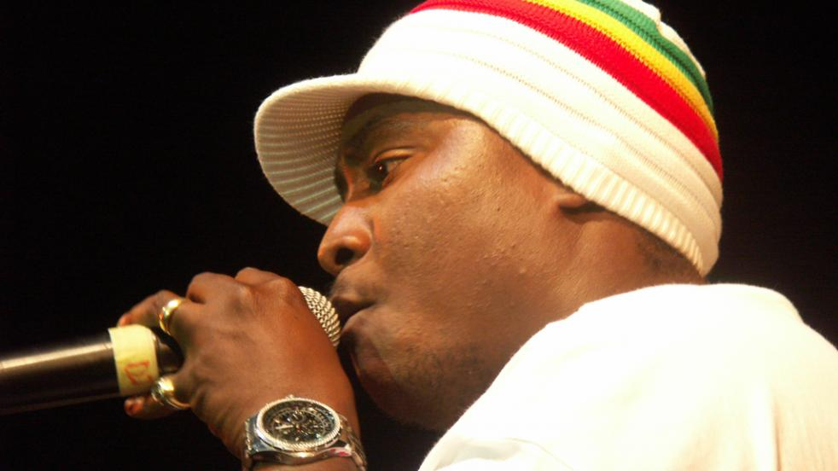
Senegalese music from social to political issues
Traditional music: Based on the ancestral rhythms and instruments of different ethnic groups (balafon, Kora, tama, sabar, etc.
Colonial influence: Introduction of new instruments and musical styles during the French colonial period.
1960s-1970s: Emergence of modern Senegalese music after independence, blending traditional and Western influences. (Star Band and Orchestra Baobab)
Mbalax: Development of this popular style in the 1970s, notably by Youssou N'Dour.
World Music: International recognition of Senegalese musicians in the 1980s-1990s. (Youssou Ndour, Baba Maal, Ismaela Lo)
Hip-hop and rap: Emergence of a dynamic hip-hop scene in the 1990s (Positive Black Soul, Dara J)
Contemporary fusion: Blending traditional and modern styles, with an openness to global influences.

Slide 10
Music, religion, and politics in Senegal:tumultuous connexions
Music as political expression: platform to gather youth to fight social and political issues.
Hip-hop and rap: Emerged in the 1990s as a powerful tool for youth political expression.
Artists like Didier Awadi, Fou Malade, and Keyti use their music to address social and political issues.
The "Y'en a Marre" (Fed Up) movement, formed by rappers and journalists in 2011, exemplifies the fusion of music and youth political activism.
Activism: Artists have been involved in political activism and even ran for political office.
.
National identity: Mbalax helps reinforce a sense of Senegalese identity.
Islamic influence: Religious themes are common in Senegalese music.
Sufi traditions: Music plays a crucial role in Sufi religious practices, particularly in the form of devotional songs
Censorship concerns: Occasionally, there are debates about the appropriateness of certain music in a religious context.
Modernization vs. tradition: Ongoing dialogue about balancing traditional religious and cultural values with musical expressions.

Slide 11
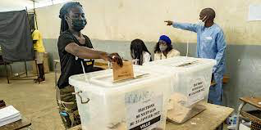
Senegalese political resilience: voting tradition and strong religious power
Senegalese started voting in the 19th century
Senegal has experienced multiple peaceful transfers of power since independence in 1960.
2000, the first opposition victory ending 40 years of Socialist Party rule.
2012 further solidified Senegal's democratic credentials.
Robust constitutional framework that keeps being strengthening democratic institutions.
From 1960 to 2011, 37 constitutional reforms with 23 strenghening democracy and 1 weakening it.
Strong civil society and media that act as watchdogs and promote accountability.
Free and independent press since the 90s
Culture of political debate and dialogue, even during times of tension.

Slide 12
